Slide 1

Welcome to Hamble Class
2025 – 2026
Notes:
NOTE: To change images on this slide, select a picture and delete it. Then click the Insert Picture icon
in the placeholder to insert your own image.

Slide 2
The Hamble Class Team
Mrs Barter
HLTA/
pre school lead
Mrs Holmes
Class Teacher
EY lead
Mrs Tingley
Class Teacher
Mrs John
Teaching Assistant
Mrs Bryder
Teaching Assistant
Mrs Brooking
Teaching Assistant
Notes:
NOTE: To change images on this slide, select a picture and delete it. Then click the Insert Picture icon
in the placeholder to insert your own image.

Slide 3
What does my child need?
Water bottle - named
Book bag – reading record / home contact book
Lunchbox – if applicable
A healthy snack if desired (fruit, yoghurt, crackers, cheese) - fruit is provided by the school for break times
Bag of spare clothes including underwear – all named
Wellies
Notes:
NOTE: To change images on this slide, select a picture and delete it. Then click the Insert Picture icon
in the placeholder to insert your own image.

Slide 4
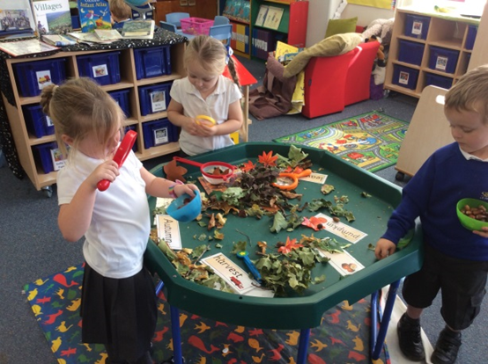

Areas of Learning
Prime Areas:
1. Personal, Social and Emotional Development (PSED)
2. Communication and Language (CL)
3. Physical Development (PD)
Specific Areas:
4. Literacy (L)
5. Mathematics (M)
6. Understanding the World (UW)
7. Expressive Arts and Design (EAD)

Slide 5
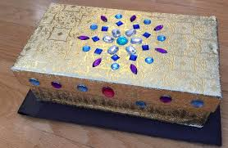
Communication and Language
Listening, Attention and Understanding
Listening in small and large groups.
Story time – being able to listen attentively and respond to what they hear.
Sharing conversations with adults and peers
Following instructions.
Speaking
show and tell – sharing their experiences or skills.
Treasure boxes – Autumn term
Circle time - participate in small groups, class and one-to –one discussions.
Provocation stations – high quality interactions planned by the team based on topics and children’s interests.
Communication and language is embedded within every part of the framework.

Slide 6
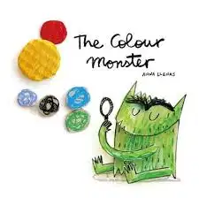

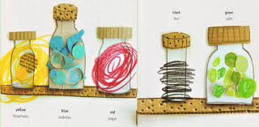
Personal, Social and Emotional
Development
Managing self
Self regulation
Confident to try new activities (Forest School, PE).
Healthy eating – being introduced to different food.
Can get changed for PE independently.
Show an understanding of their own feelings.
The ability to wait for what they want.
Building relationships
Taking turns.
Positive relationships with adults and peers.
Sensitive to others’ needs.

Slide 7
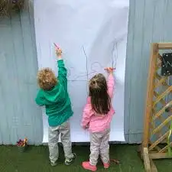
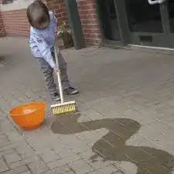
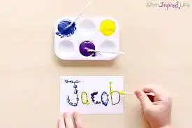
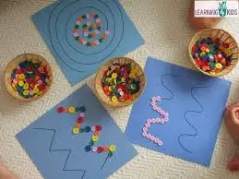

Physical Development
Gross motor skills
Ability to move energetically – running, jumping, dancing, hopping, skipping
Coordination / balance.
Negotiate space and obstacles safely.
Climbing.
Big movements!
Fine motor skills
Hold a pencil using the tripod grip.
Use a range of small tools; scissors.
Small, more controlled movements.
Starting to take care when drawing.

Slide 8

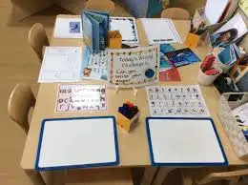

Literacy
Comprehension
Word reading
Anticipate key events in stories. I wonder what might happen next…
Fiction and non fiction, poems, nursery rhymes.
Story telling language – traditional tales.
Use and understand recently introduced vocabulary during discussions about stories, non-fiction, rhymes and poems and during role-play.
Song of Sounds phonics scheme.
Use their phonic knowledge to sound out and blend.
Recognise tricky words (the, to, my, was).
Literacy development
Writing
Letter formation.
Use phonics to sound out and write words
Spell a few tricky words from memory (the, was, my) and spell words using their phonics.
Write sentences that can be read by others.
Slinfold Writing Approach

Slide 9
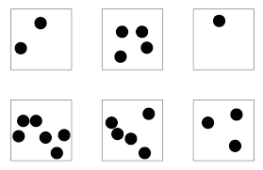
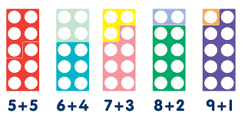

Mathematics
Number
A deeper understanding of numbers to 10, including the composition of each number.
Subitise up to 5 (recognise quantities without counting)
Automatically recall numbers bonds to 5 (to 10).
Numerical patterns
Verbally count to 20.
Recognise the counting system.
Compare quantities up to 10 in different contexts (one more, one less, more, fewer, sharing, doubling, odd and even).

Slide 10
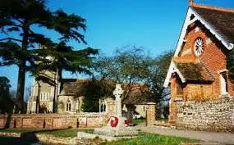
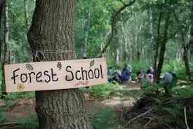
Understanding of the world
Past and present
People, Culture and
Communities
All about me – treasure boxes.
Talk about their immediate family, extended family, where they live.
Know some similarities and differences between things in the past and now.
A wider understanding about different cultures and religions, in the UK and around the world.
Comparisons between life in the UK and life in other countries.
Strong links with St Peter’s Church.
The natural world
Forest schools / Green Learning
Observing the natural world around them- animals and plants.
Looking after our planet.
Observing the seasons.

Slide 11

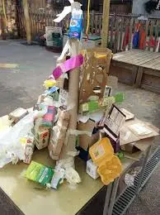
Expressive Arts and Design
Creating with materials
Safely use and explore variety of materials, tools and techniques.
The magic of junk modelling!
Use hand made props to enhance play.
Being imaginative and
Expressive
Invent, adapt and recount stories with peers (Traditional tales).
Singing; including a range of well known nursery rhymes.
Performances during play.
Perform songs, rhymes, poems and stories.
Harvest festival, Nativity, Easter

Slide 12
Maths – y1
We follow a programme called White Rose across the whole school.
We will start on place value units, followed by addition and subtraction.
In KS1, we also follow the Mastering Number Programme.
We will be doing a ‘Maths Meeting’ twice a week to go over key skills.
Notes:
NOTE: To change images on this slide, select a picture and delete it. Then click the Insert Picture icon
in the placeholder to insert your own image.

Slide 13
Writing – y1
All writing will be based around a text. We will be having a focus on the basics - capital letters, full stops etc and an understanding of what makes a sentence a sentence - subject/verb. We will be retelling and acting out stories and creating our own characters.
Notes:
NOTE: To change images on this slide, select a picture and delete it. Then click the Insert Picture icon
in the placeholder to insert your own image.

Slide 14
Science – y1
  Animals including humans
  Habitats
  Seasonal Change
  Everyday Materials
  Plants
Notes:
NOTE: To change images on this slide, select a picture and delete it. Then click the Insert Picture icon
in the placeholder to insert your own image.

Slide 15
Our Topics
Autumn
Super me!
Up up and away – learning about our school, where we live and then comparisons with a non EU country - Kenya
Spring
On the move
Summer
Pirates / Explorers / Seaside
Notes:
NOTE: To change images on this slide, select a picture and delete it. Then click the Insert Picture icon
in the placeholder to insert your own image.

Slide 16
Assessment
School assessments
Statutory Assessments
Reception: Baseline Assessment
Reception: EYFS Profile – June 2026
Year 1: Phonics Screening Check – June 2026
Song of Sounds assessments
NFER booklets Yr1 Summer term)
Formative Assessments
Notes:
NOTE: To change images on this slide, select a picture and delete it. Then click the Insert Picture icon
in the placeholder to insert your own image.

Slide 17
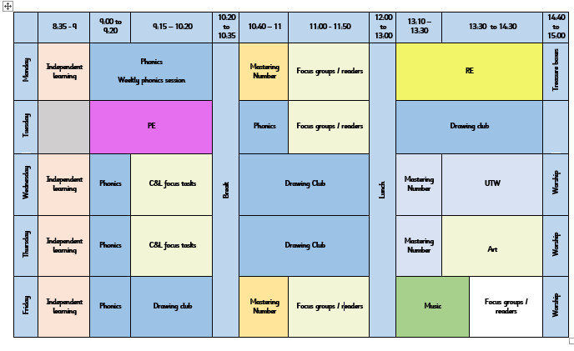
Our Timetable
The Purely Sport team teach Hamble PE on a Tuesday morning and Mrs Barter teaches Monday afternoon and Tuesday from after playtime.
An example of our timetable
We run continuous provision throughout the day, where the children access different areas of the classroom, completing adult directed and their own self - initiated tasks
Notes:
NOTE: To change images on this slide, select a picture and delete it. Then click the Insert Picture icon
in the placeholder to insert your own image.

Slide 18
Forest School
Hamble class will attend forest school sessions in the Spring term.
We will send a list out of what is needed nearer the time.
Show and tell
Show and tell will be held on a Monday and Friday afternoon.
We would like to encourage WOW moments – learning a new skill, a swimming award, sharing exciting news etc
Please rehearse with your child to help prepare them for their show and tell. Uploading photos onto Tapestry is a useful way to share photos and help children share their wow moments with the class.
Birthdays
Children are allowed to wear their own clothes on their birthdays. If they have a birthday during a school holiday or on a weekend, they can choose the next nearest school day to wear their own clothes to school.

Slide 19
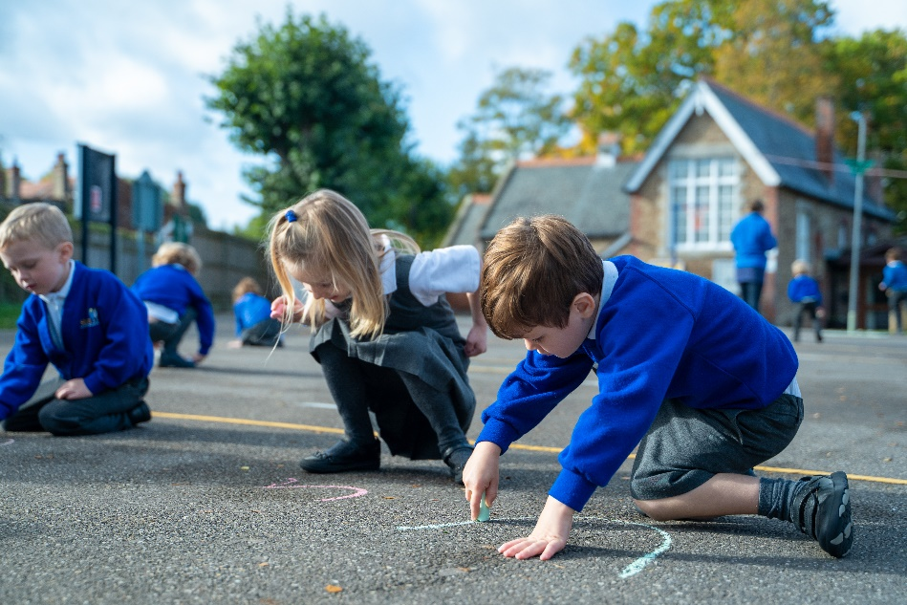
Phonics Workshop
A phonics presentation will be delivered by the Hamble team in
the next few weeks.
Families will then be invited into Hamble Class later
in the term to take part in a phonics session with
their child. A letter will go out next week with
more information and dates for these sessions.
Notes:
NOTE: To change images on this slide, select a picture and delete it. Then click the Insert Picture icon
in the placeholder to insert your own image.

Slide 20

Home Learning
Home learning for Reception will start in the new year.
Communication and language will be our focus. This will be set on Tapestry.
Home learning for Year 1 will be set on a Friday and due in the following Thursday
The tasks set will revisit and help to consolidate your child’s prior learning
These will be alternate between Phonics/ Reading and Maths tasks.
Notes:
NOTE: To change images on this slide, select a picture and delete it. Then click the Insert Picture icon
in the placeholder to insert your own image.

Slide 21

Home Learning – Reading
Reading with and to your child helps them to access all areas of the curriculum – this can’t be done too much!
Promoting a love for reading is key
There is more to reading than just ‘reading’ – exploring the cover, blurb, making predictions, looking at vocabulary…
Big Cat Collins Reading Books – suggestions at the back of the book
Books will be changed on a Monday & Friday
Notes:
NOTE: To change images on this slide, select a picture and delete it. Then click the Insert Picture icon
in the placeholder to insert your own image.

Slide 22
Behaviour and expectations
Class Charter
Class Marbles
  Written by the children
  Will be displayed on the wall and referred to
  Marbles are awarded in class and
  the children work towards an end of term marble reward.
House points
Values Certificates
  awarded for good work,
working hard, being polite etc and
upholding the school values
  Weekly certificates in worship

Slide 23
Thank you for coming!
Do you have any questions?

