Slide 1
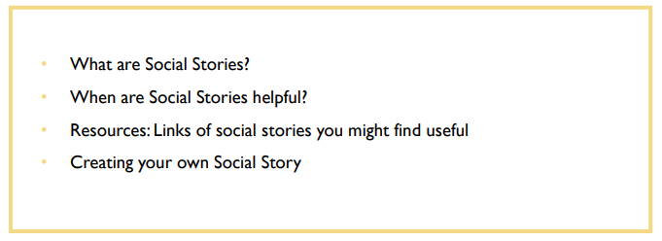
Social Stories

Slide 2
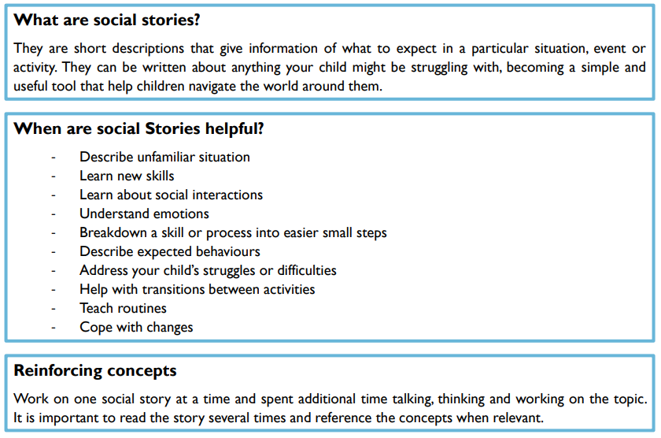

Slide 3
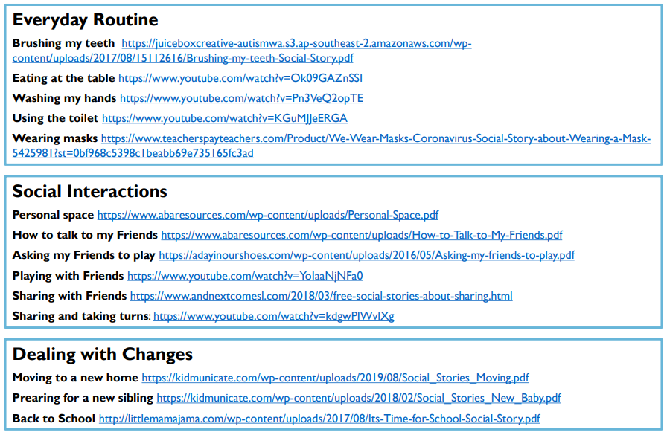

Slide 4
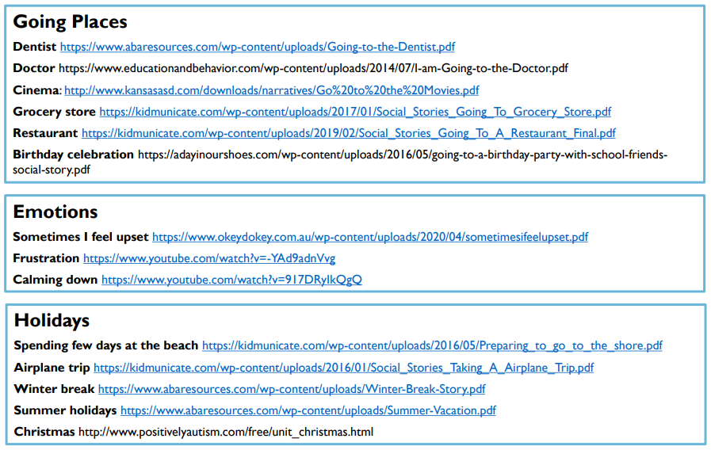

Slide 5
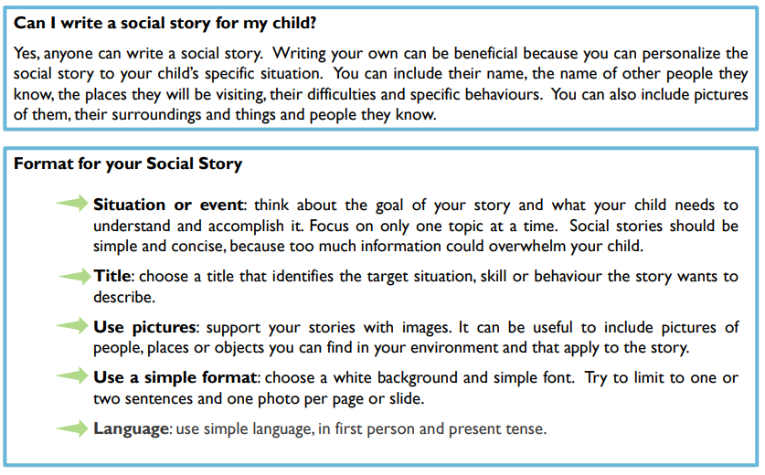

Slide 6
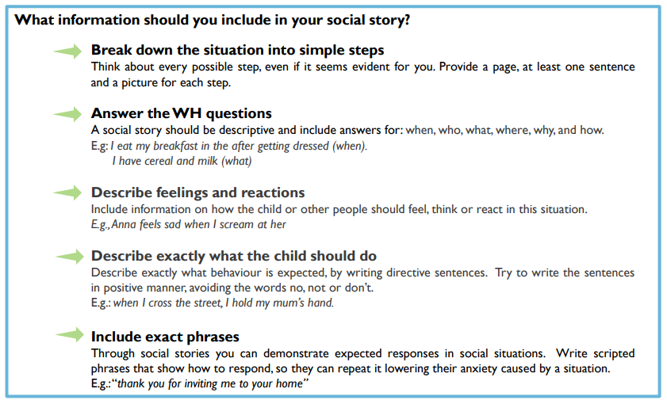

Slide 7
If you are struggling to find a suitable social story for your child – please do not hesitate to contact me on –
ccollins@slinfold.w-sussex.sch.uk

